Slide 1
(1) Nonlinear in CMP system (2) Waves in 1D waveguide cavity
Yutong Zhao
Sept 17th 2018

Slide 2
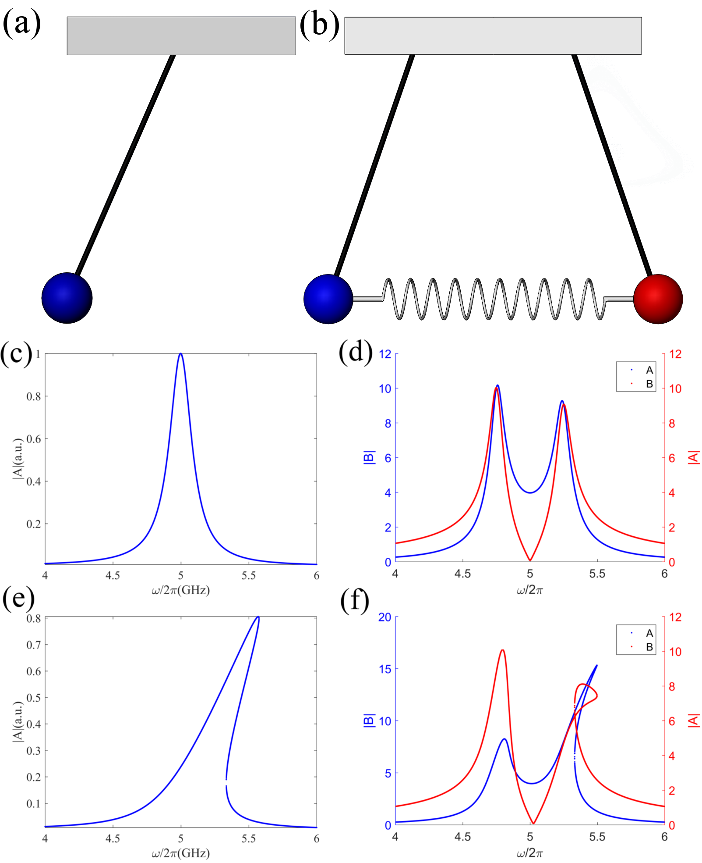
Nonlinear in CMP system

Slide 3
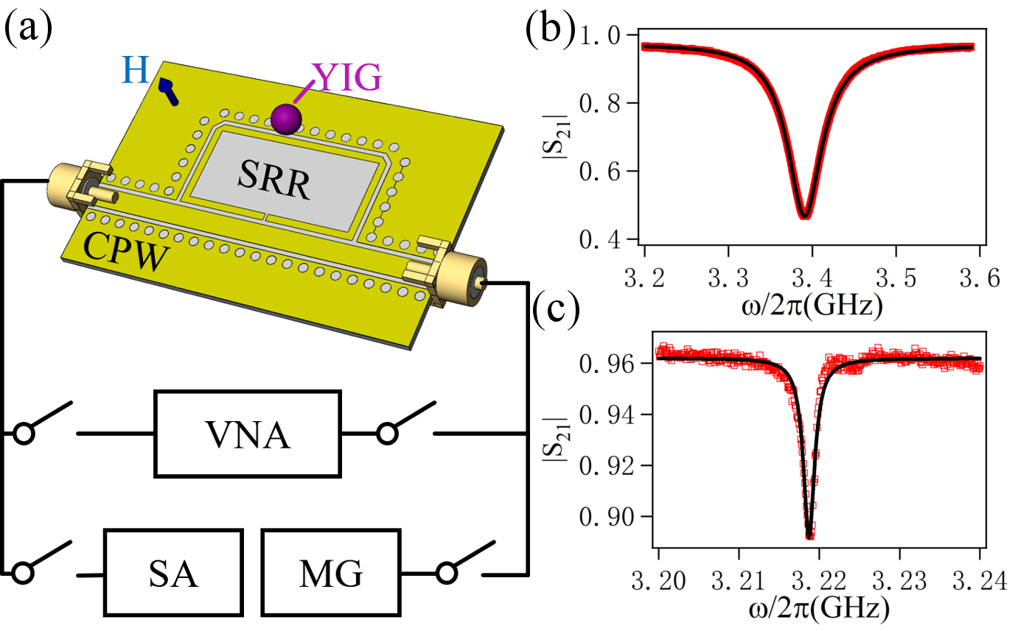

Slide 4
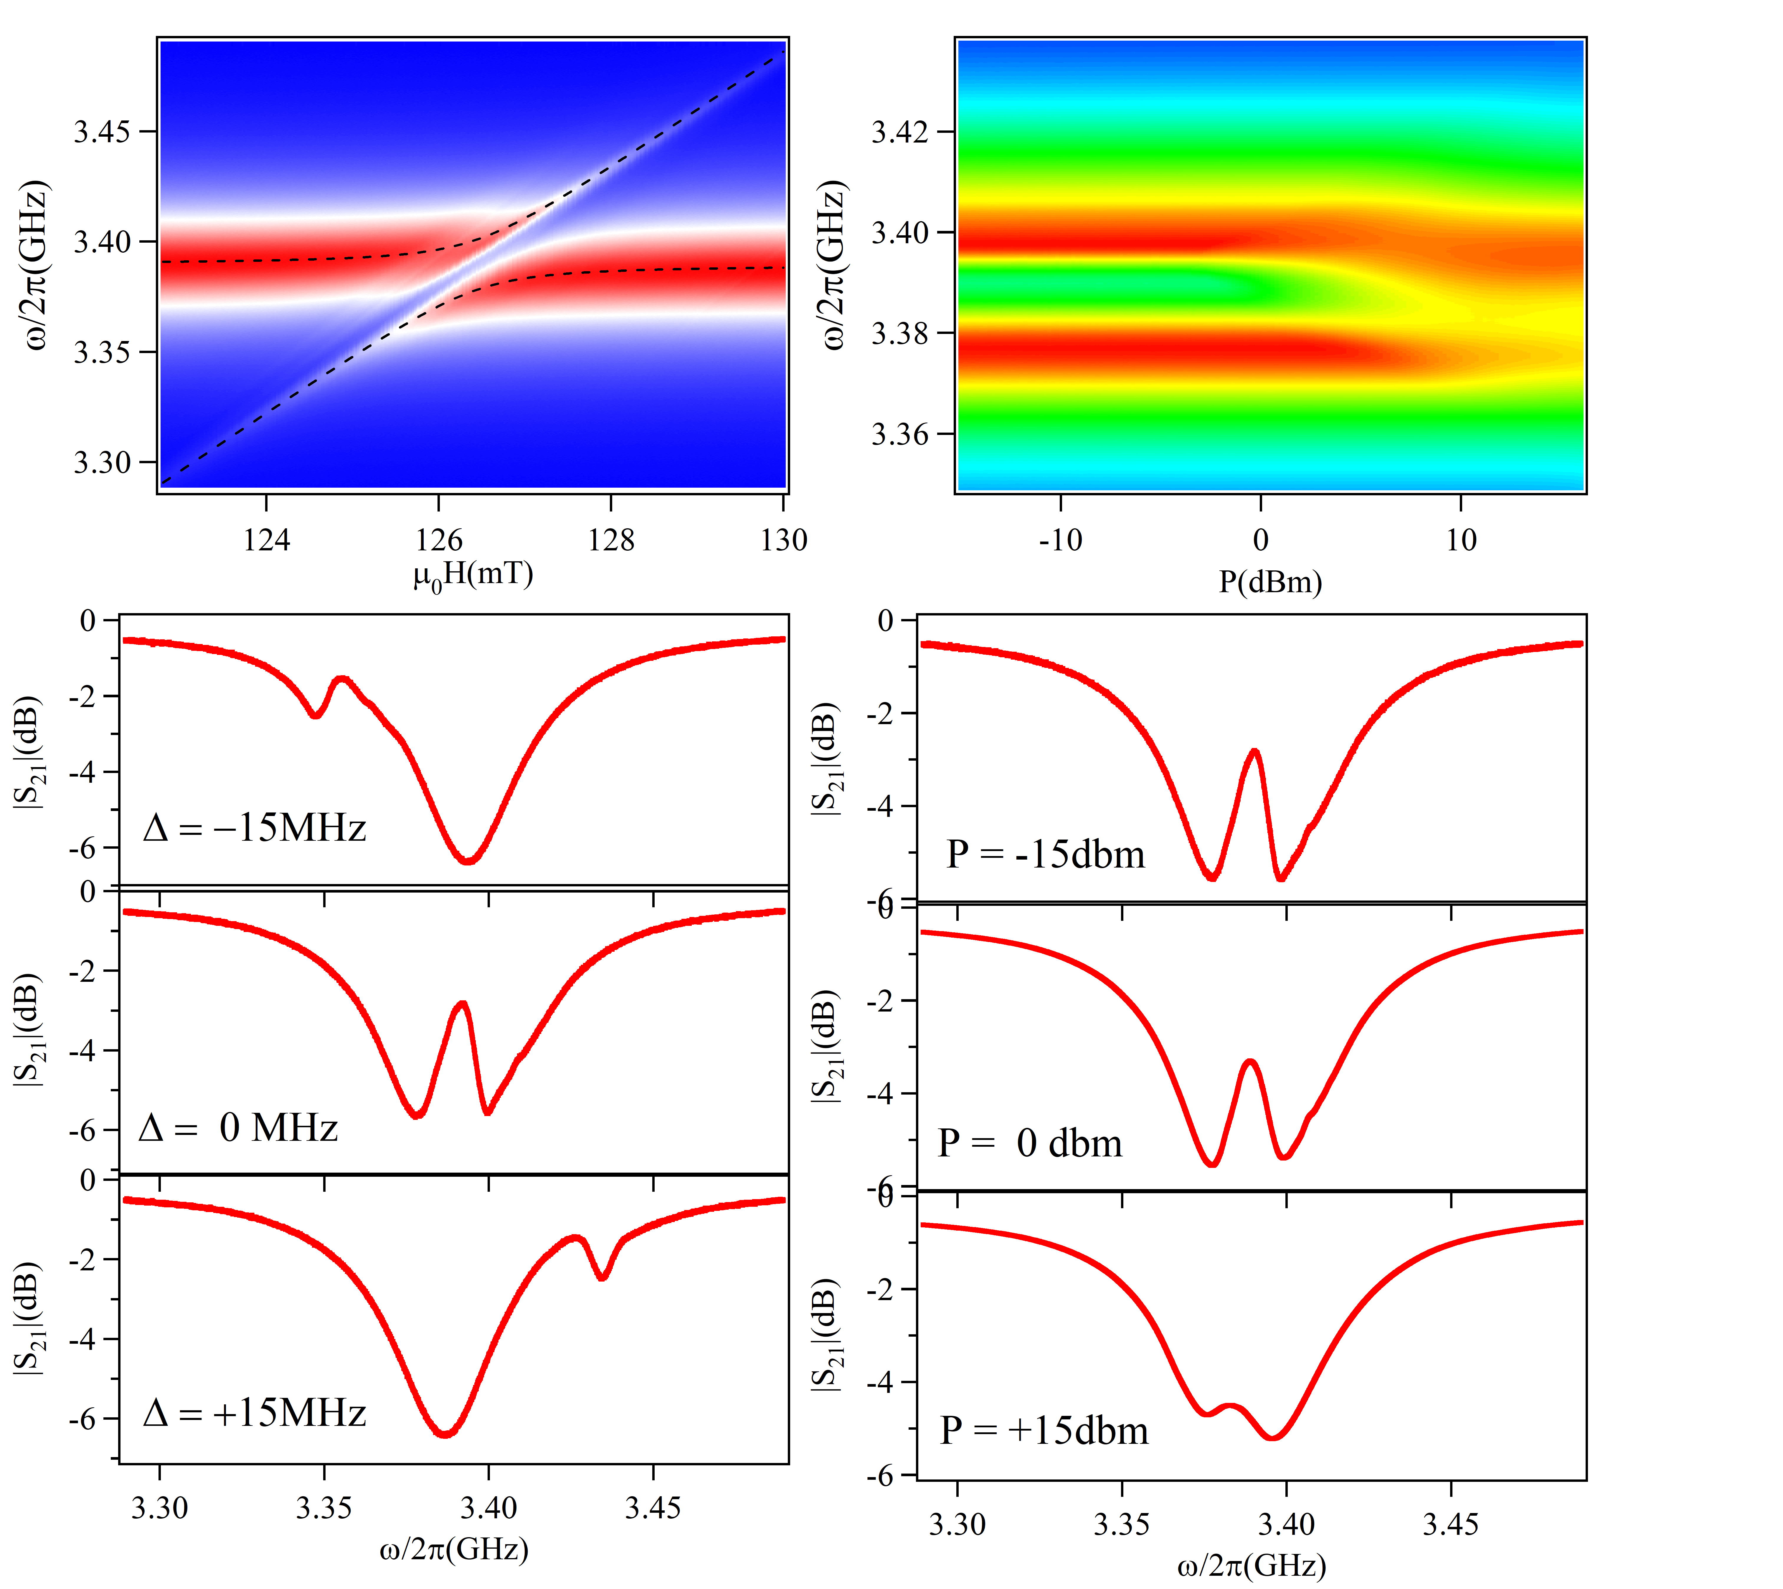
(a)
(b)
(c)
(d)

Slide 5
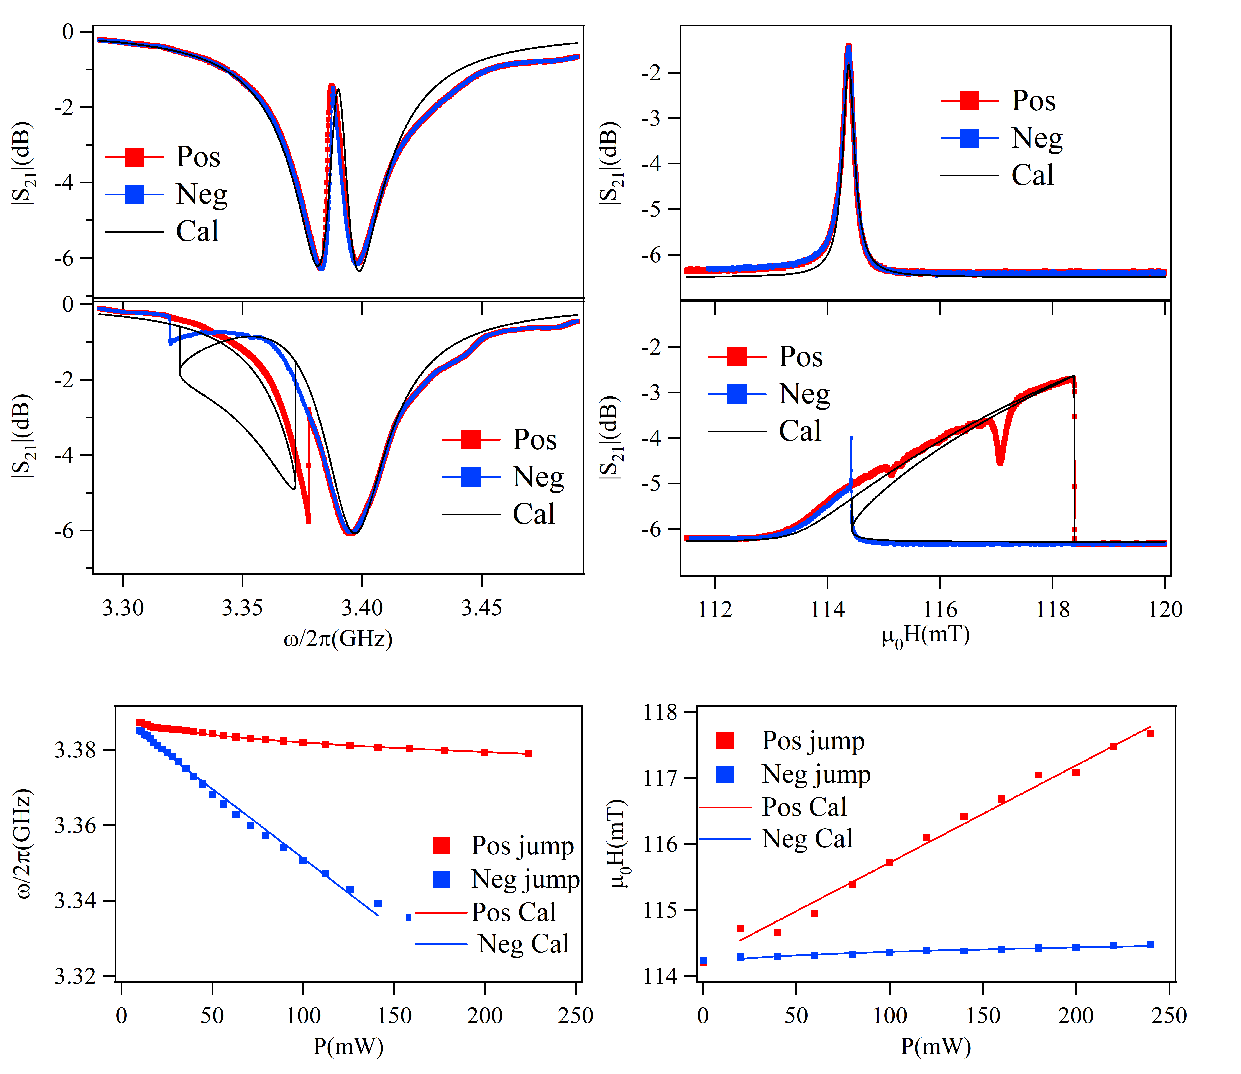

(a)
(c)
Improve:
Adjust parameters
(b)
(d)
$$P$$

Slide 6
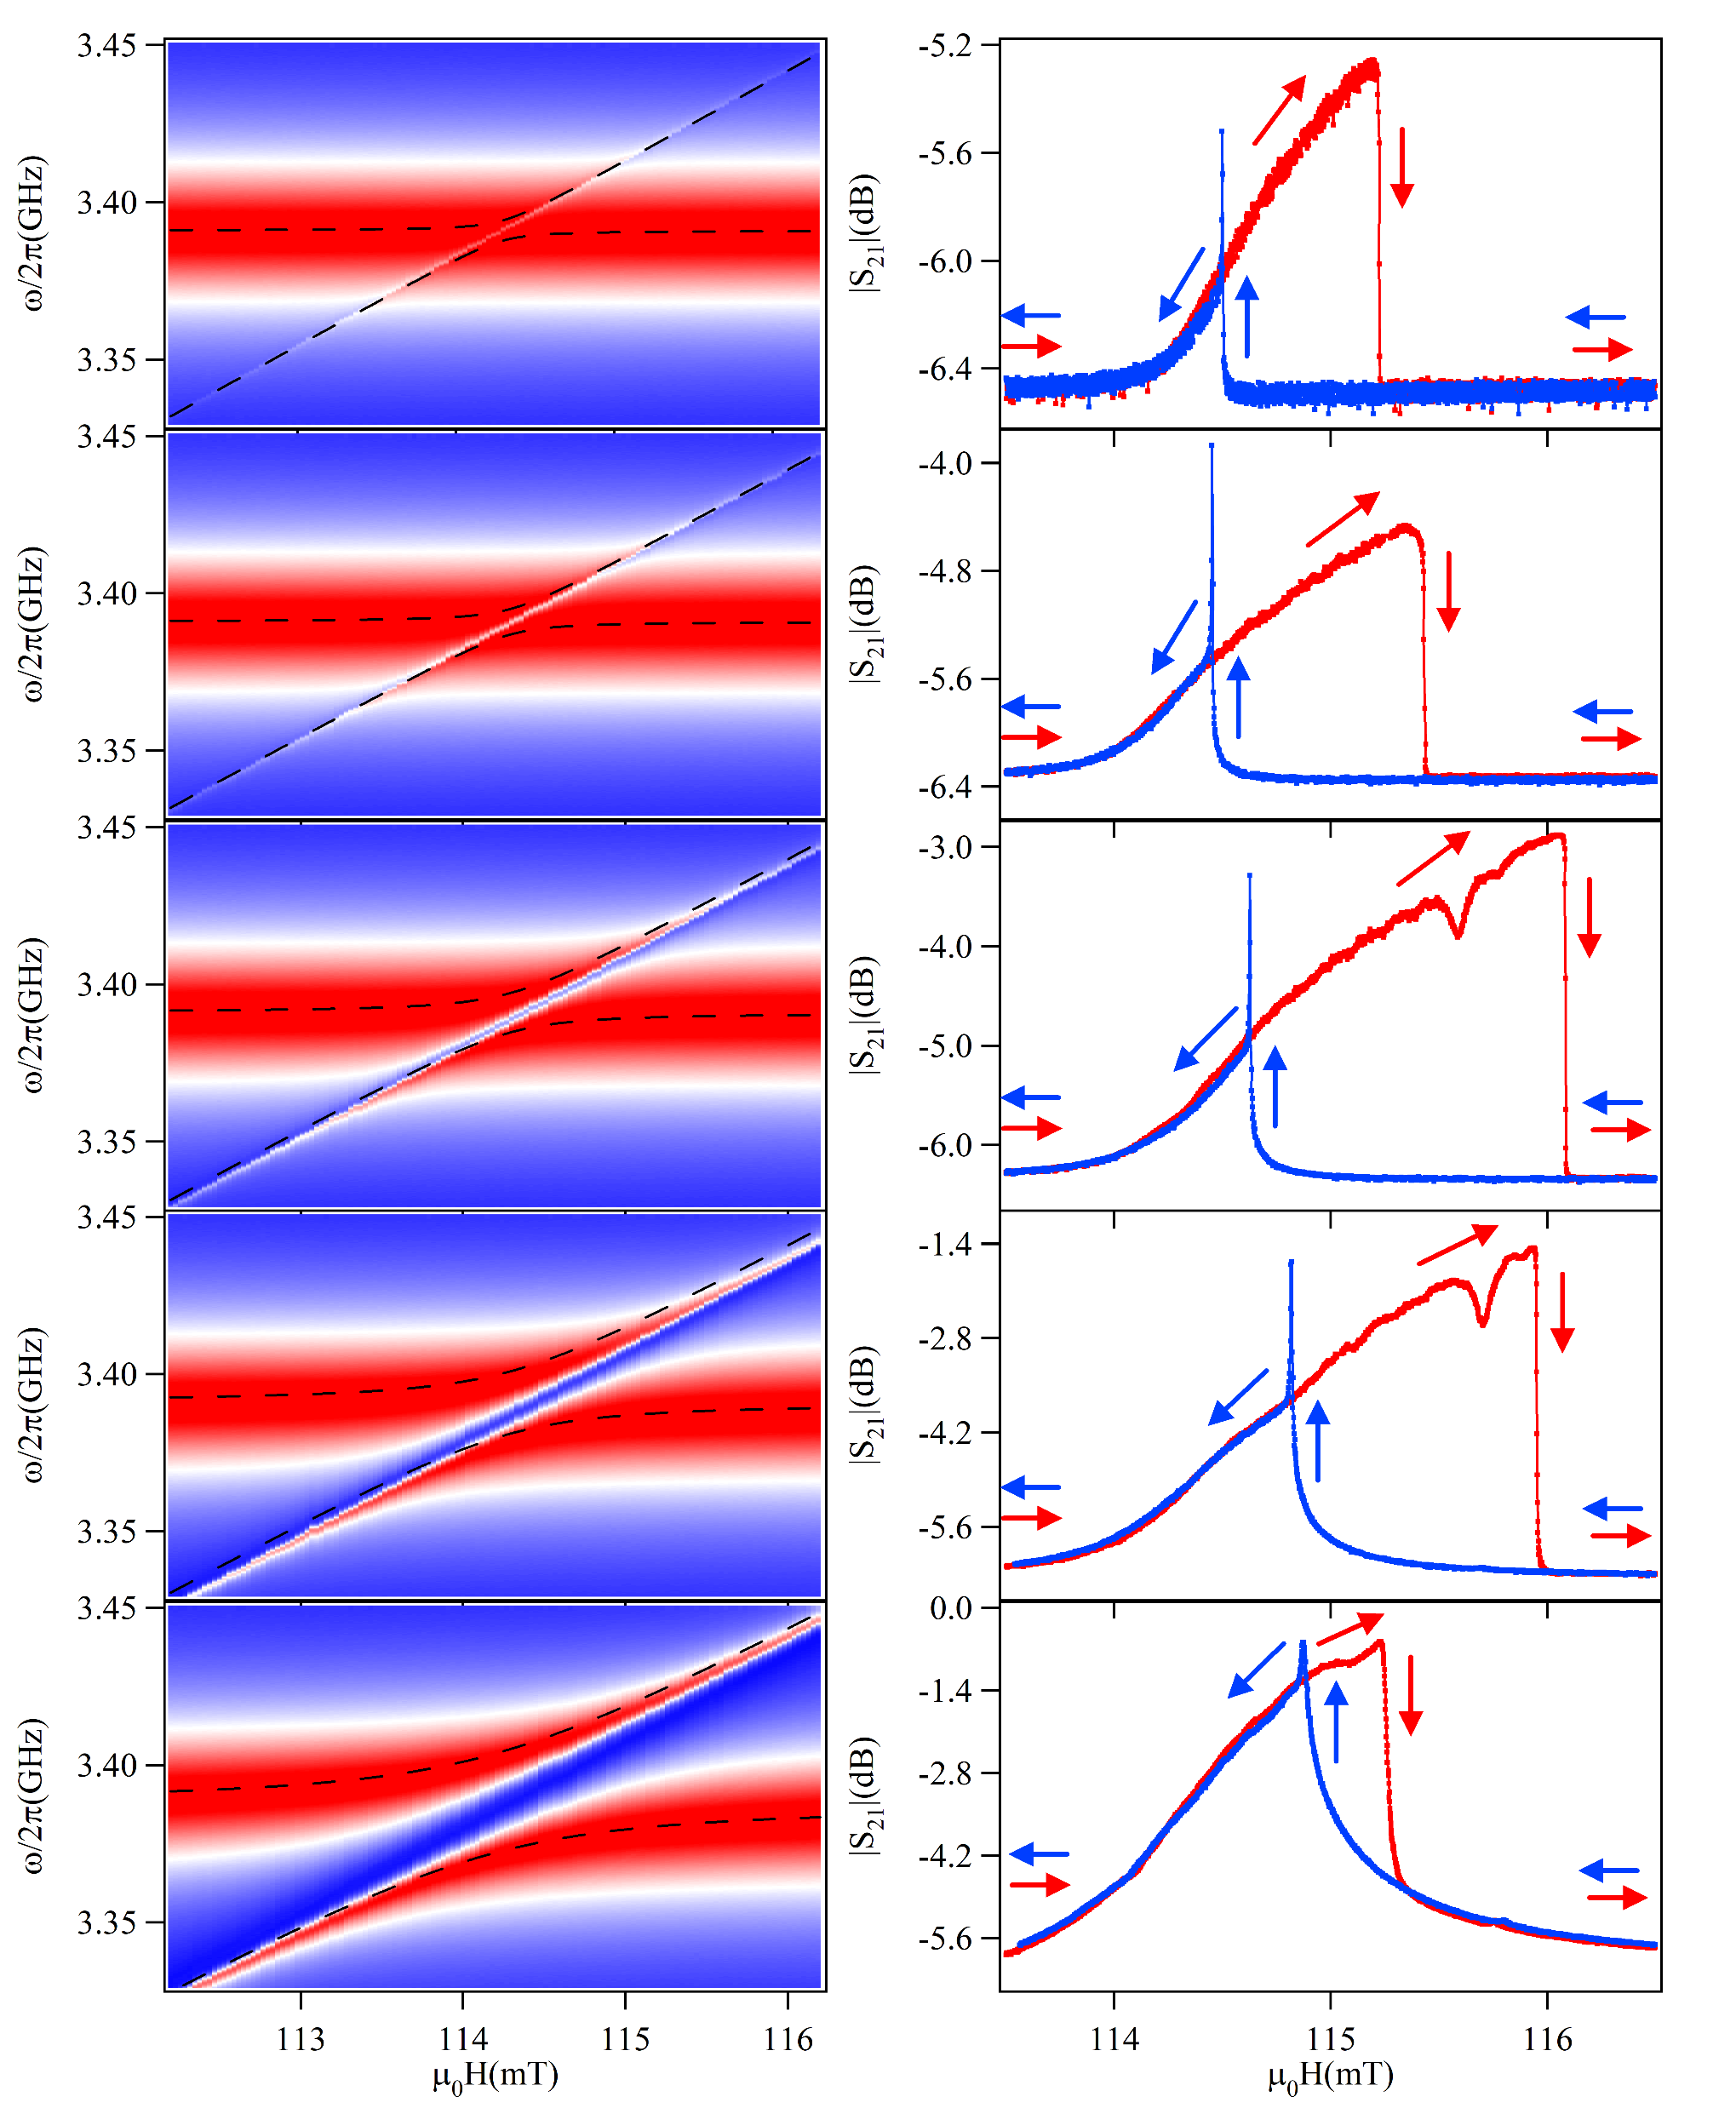
(a)
(b)
Δ= 1.20mT
g = 3.23MHz
Δ= 1.41mT
g = 4.07MHz
Δ= 1.94mT
g = 6.26MHz
Δ= 1.63mT
g = 9.92MHz
Δ= 0.91mT
g = 15.77MHz

Slide 7
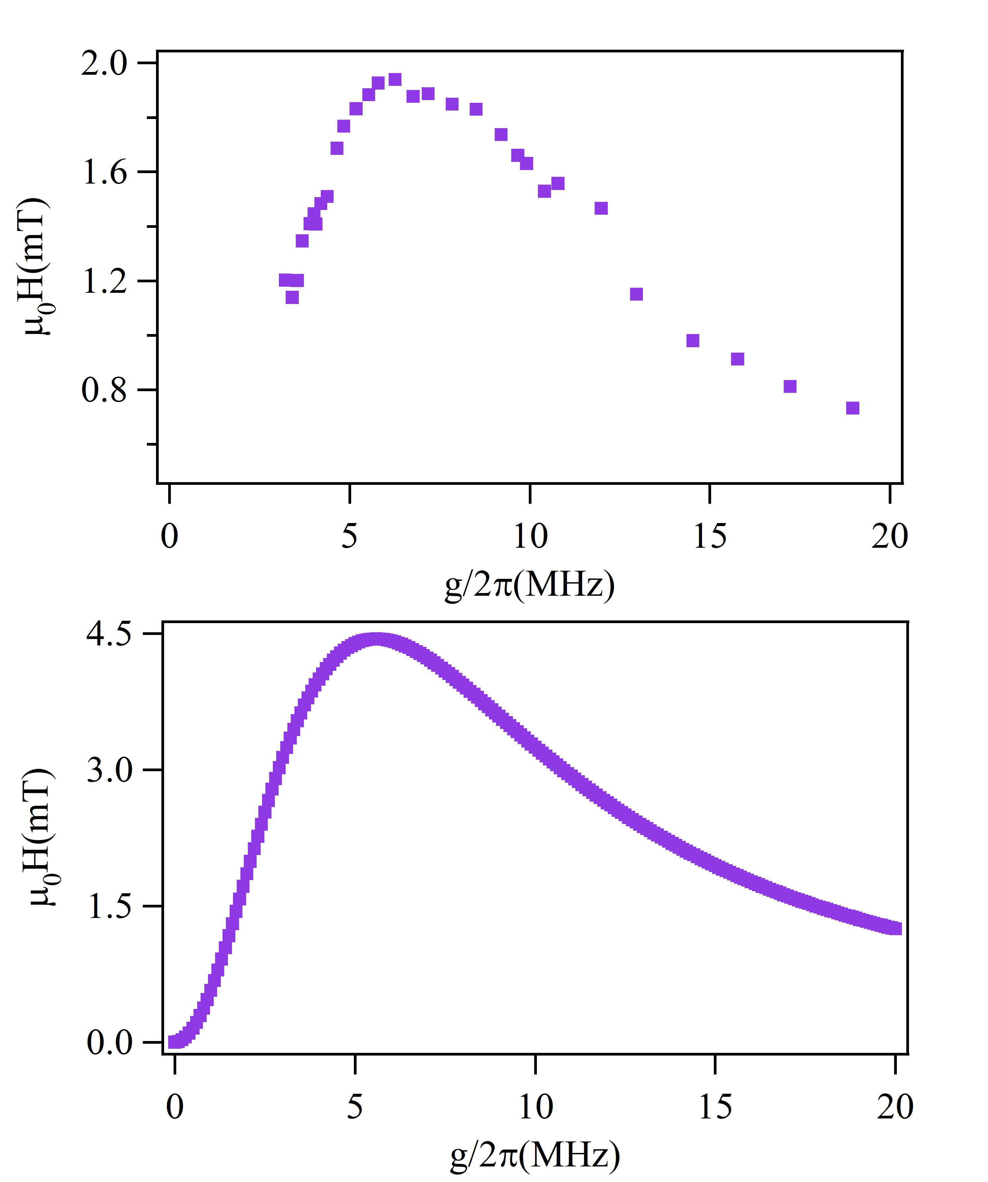
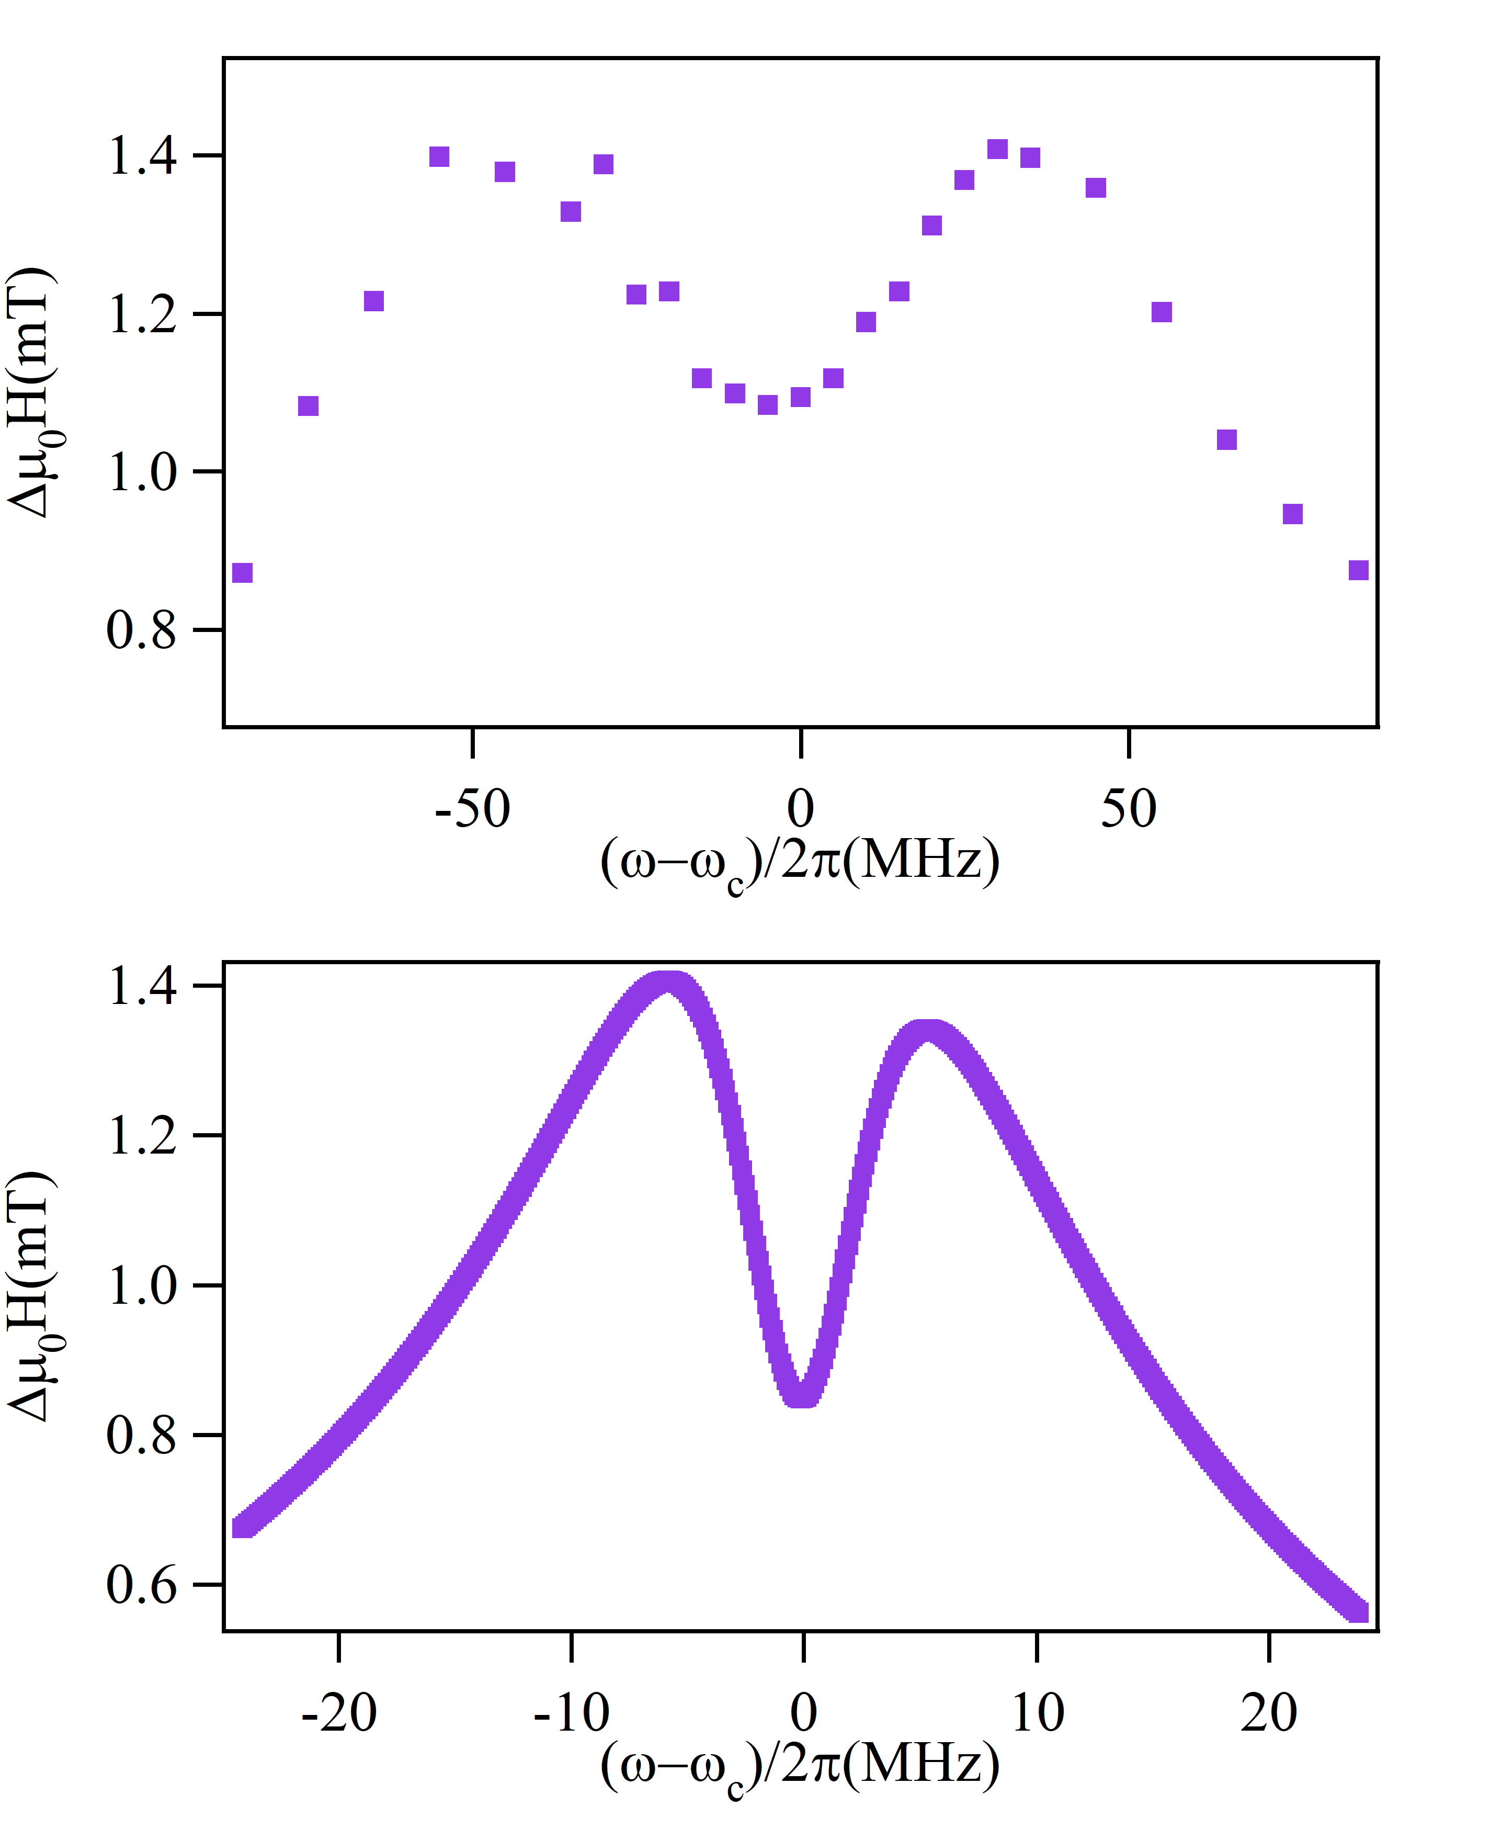
Coupling Strength
Detuning
(a)
(c)
Measurement
Measurement
(b)
(d)
Calculation
Calculation
Improve:
Adjust parameters

Slide 8
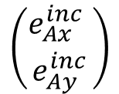
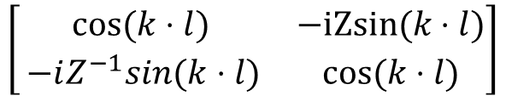
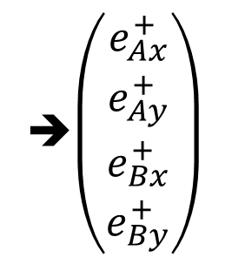
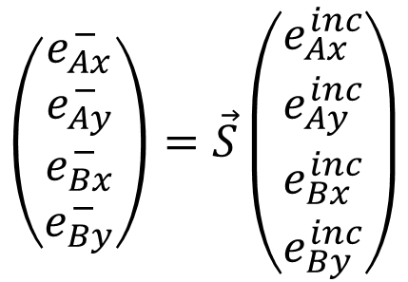



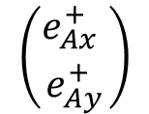

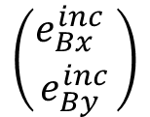
Waves in 1D waveguide cavity
A
$R=(\begin{matrix}cosθ & sinθ \\ −sinθ & cosθ\end{matrix})$
B
$$\left({e_{Ax}^{inc} \atop e_{Ay}^{inc}}\right)$$
$$\left({e_{Ax}^{+} \atop e_{Ay}^{+}}\right)$$
$$\left({e_{Bx}^{+} \atop e_{By}^{+}}\right)$$
$$\left({e_{Bx}^{inc} \atop e_{By}^{inc}}\right)$$
$$\left[\begin{matrix}0 & 0 \\ 0 & e^{iφ}\end{matrix}\right]$$
$$\left[\begin{matrix}cos⁡(k⋅l) & −iZsin⁡(k⋅l) \\ ⁡−iZ^{−1}sin(k⋅l) & cos⁡(k⋅l)\end{matrix}\right]$$
$$R\left[\begin{matrix}0 & 0 \\ 0 & e^{iφ}\end{matrix}\right]R^{∗}$$
$$\left(\begin{matrix}\begin{matrix}e_{Ax}^{−} \\ e_{Ay}^{−}\end{matrix} \\ \begin{matrix}e_{Bx}^{−} \\ e_{By}^{−}\end{matrix}\end{matrix}\right)=\vec{S}\left(\begin{matrix}\begin{matrix}e_{Ax}^{inc} \\ e_{Ay}^{inc}\end{matrix} \\ \begin{matrix}e_{Bx}^{inc} \\ e_{By}^{inc}\end{matrix}\end{matrix}\right)$$
➔$\left(\begin{matrix}\begin{matrix}e_{Ax}^{+} \\ e_{Ay}^{+}\end{matrix} \\ \begin{matrix}e_{Bx}^{+} \\ e_{By}^{+}\end{matrix}\end{matrix}\right)$

Slide 9
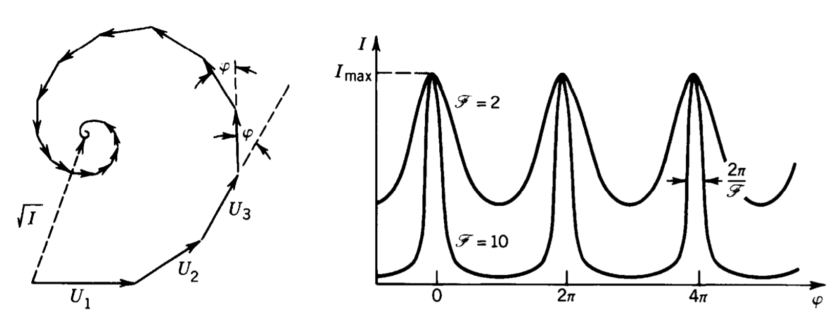

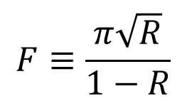
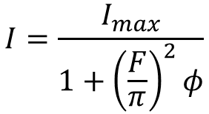
Multi-wave Physics:
interference of infinite number of waves with progressively small amplitude and equal phase difference
$$h=Re^{iφ}$$
$$I=\frac{I_{max}}{1+{\left(\frac{F}{π}\right)}^{2}φ}$$
$$F≡\frac{π\sqrt{R}}{1−R}$$
Finesse parameter

